Slide 1

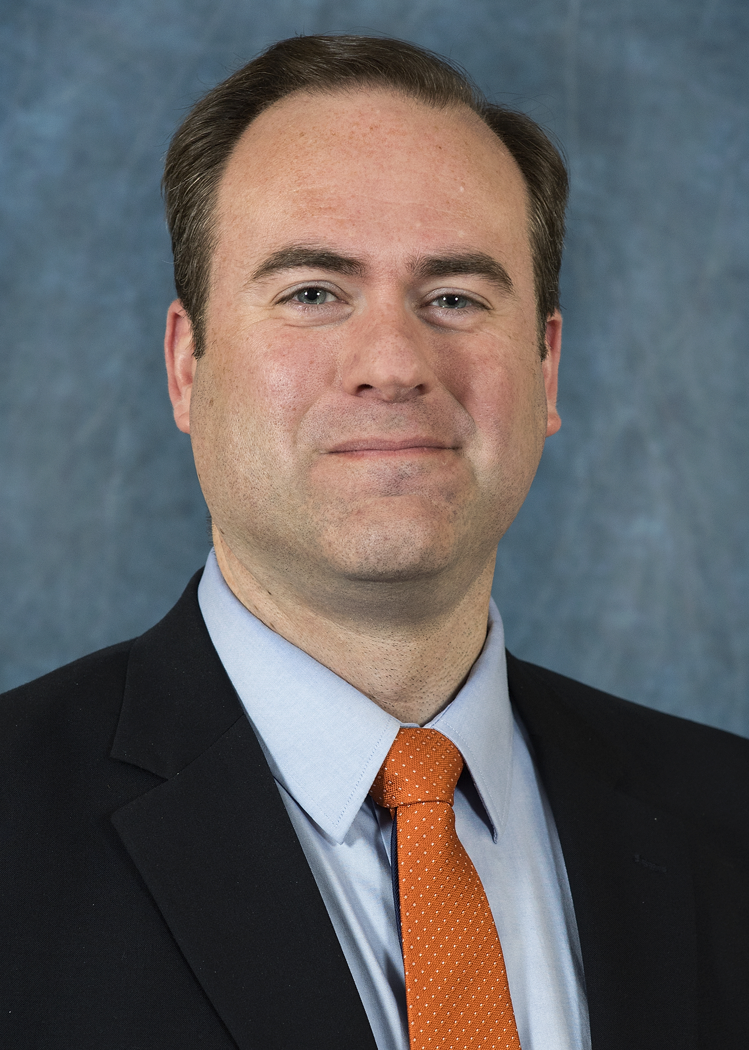
Supporting and Developing Faculty and Staff: A History and Vision for TALA
Christopher Maynard, PhD
Vice Provost
Sam Houston State University
President
Texas Council of Chief Academic Officers (TCCAO)

Slide 2


Timeline:
Texas Academic Leadership Academy
Fall 2017: TCCAO formed a committee and invited applications for the development for a state-wide leadership academy focused on higher education.
January 12, 2018: Stacey Edmonson, Matt Fuller, and Chris Maynard from Sam Houston State University presented plan to TCCAO.
2018-19: Cohort 1
2019-20: Cohort 2
2020-21: Cohort 3

Slide 3
Need for Leadership Development
The capacity to wear many “hats”
  Diverse student bodies
  Securing campus environments
  Demonstrating efficacy of program
  Coping with legal issues
  Organizational situations
Experts in teaching, research, and service…but not leadership
Needs of Texas Higher Education: 60X30

Slide 4
Purpose
Develop high potential academic leaders
Offer an in-depth and interactive understanding of university leadership
Develop statewide capacity for effective leadership
Do this in a cost-effective manner

Slide 5
Beliefs and Values
State-wide, far-reaching effort that includes representatives and voices from all forms of higher education in the state
Focus on the unique needs of Texas’ higher education systems (60x30)
Active learning experience for participants
Practical applications and research familiarity outcomes
Founded upon sound evidence
Effective mentoring is a powerful tool for enhancing leaders’ capacities for leading
Address and enhance leaders’ capacities to apply what they have learned

Slide 6
Curriculum
Conflict resolution
Evaluating personnel
Enhancing teaching, learning, online learning, and innovation
Budgeting and finance
Strategic planning
Diversity and cultural responsiveness
Assessment
Accreditation
Student success

Slide 7
Delivery
On-site meetings
Individual campus mentoring
Interactive online synchronous and asynchronous interactions
Guided readings

Slide 8
Participant Selection
Institutional executive leaders nominate aspiring leaders
Vita
Application Form
Committee of TCCAO members reviews applicants based on rubric
Select 1-3 participants each year per institution
Written response to prompt
Letter of recommendation/nomination
Submit completed nominations
Give formative feedback

Slide 9
Participant Outcomes
Mentoring
  Fellows will have a mentor from their campus and a mentor from another campus based upon individual career path and goals
  Five Mentor/Mentee “check ins” to discuss goals, challenges, and future direction
Individual Leadership Development Plans (ILDP)
  Each participant will develop a personal plan
  Includes personal goals, experience gaps, desired experiences, timeline, and reflections
Portfolio
  Fellows will each create a Leadership Reflective Portfolio
  Include activities from individual institutions based on common topics

Slide 10
Learning Outcomes
Articulate expectations for Academy, goals, and initial abilities
Define personal philosophy of leadership
Effectively resolve conflicts
Articulate a philosophy and plan for improving teaching and learning at their institution
Ability to evaluate faculty and staff and refine policies for tenure, promotion, and evaluation
Articulate a philosophy and plan for enhancing discourses of diversity, cultural responsiveness, ethical leadership, and self-awareness
Articulate a philosophy and plan for the use of evidence in decision-making
Plan for student activism, support free speech, and respond to protests
Respond to federal and state regulations
Maintain system of campus safety and crisis responsiveness
Further explore knowledge, skills, and dispositions needed for academic leadership

